Slide 1
Chapter 10 Arrays and Addressing Modes

Slide 2
Overview
An array is a collection of sequentially indexed elements, each element having the same type.
Examples: A list of names A list of temperatures
Each element of the array has a unique index number identifying that element.
Why do we need arrays?
Imagine keeping track of 5 test scores, or 100, or 1000 in memory
How would you name all the variables?
How would you process each of the variables?

Slide 3
10.1 One Dimensional Arrays
A one-dimensional array is an ordered list of elements, all of the same type.
To define an array in assembly language
W dw 10,20,30,40,50,60
The address of the array variable is called the base address of the array
If the offset address of the array is 0200h, the array looks like this in memory:
element offset address symbolic address contents
W[0] 0200h W 10
W[1] 0202h W+2h 20
W[2] 0204h W+4h 30
W[3] 0206h W+6h 40

Slide 4
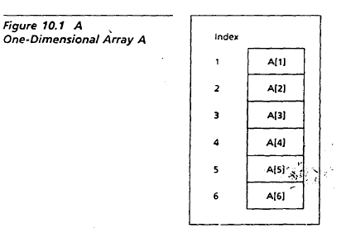
Arrays
The DB and DW pseudo-ops to declare byte and word arrays;
Example, a five-character string named MSG,
MSG DB 'abcde'
Or
A word array W of six integers, initialized to I0,20,30,40,50,60.
W Dw 10, 20, 30, 40, 50, 60
In mathematics, if A is an array. then elements are usually denoted by A[1], A[2], A[3], and so on.
Note:
The first array memory location is identified as index 1, the second one as index 2, and so on.
We use the subscript operator [ ] and an index number to reference or access the element stored in an array location.
The length of an array refers to its physical size or the physical number of memory locations in the array when it was created.

Slide 5
The DUP Operator
Arrays whose elements share a common initial value are defined using the DUP (duplicate) pseudo-op
It has the form:
Repeat_count DUP (value)
Example:
gamma DW 100 DUP(0)
sets up an array of 100 words, with each entry initialized to 0
delta Db 212 DUP(?)
sets up an array of 212 uninitialized bytes

Slide 6
Nested DUP Operator
DUPs may be nested. For example,
myvar1 db 4 dup('stack’) ; 20bytes: "stackstackstackstack“
DUP may be nested
LINE DB 5, 4, 3 DUP (2, 3 DUP (0), 1)
LINE DB 5,4,2,0,0,0,1,2,0,0,0,1,2,0,0,0,1

Slide 7
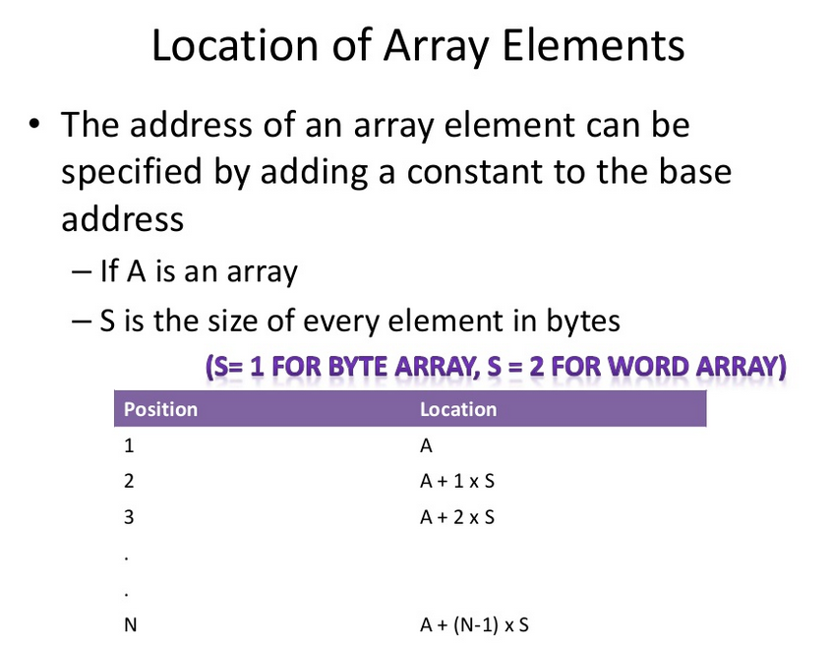

Slide 8
Example: Assessing Array Elements
Example: Exchange 10th and 25th element of an array
Solution:
W[10] is located at W + 9x2 = W + 18
W[25] is located at W + 24x2 = W + 48
MOV AX, W + 18
XCHG W+48, AX
MOV W+18, AX

Slide 9
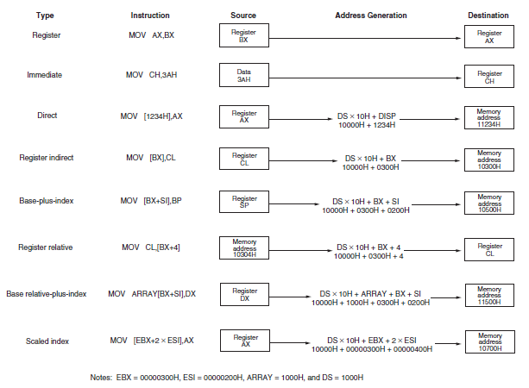
Addressing Modes

Slide 10
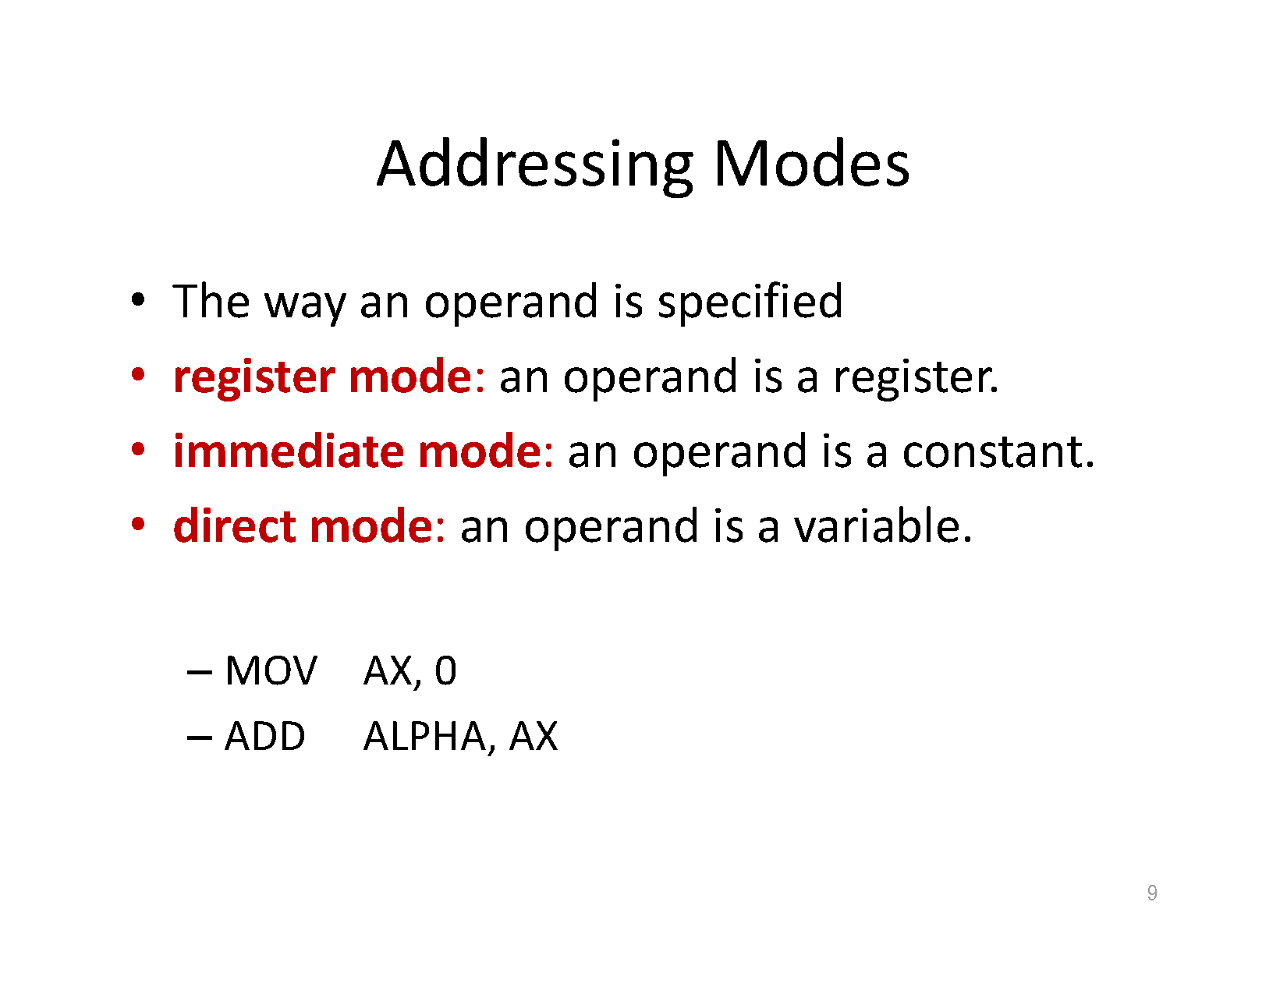

Slide 11
Register Mode
Register addressing transfers a copy of a byte or word from the source
register or contents of a memory location to the destination register or memory location.
Example:
MOV CX, DX
This instruction copies the word-sized contents of register DX into register CX.
MOV AX,BX ;copy contents of BX into AX
MOV CL,DH ;copy contents of DH into CL
MOV CL,CH ;copy contents of CH into CL
MOV AX,CS ;copy CS into DS (two steps)
MOV DS,AX
MOV CS,AX ;copy AX into CS (causes problems)

Slide 12
Immediate Addressing Mode
Immediate addressing transfers the source, an immediate byte, word, doubleword, or quadword of data, into the destination register or memory location.
Note: (The term immediate implies that the data immediately follow the hexadecimal opcode in the memory. Also note that immediate data are constant data, whereas the data transferred from a register or memory location are variable data.)
Example:
MOV AL, 22H
this instruction copies a byte-sized 22H into register AL.
MOV AX, 44H ;16 bits Copies 0044H into AX
MOV SI, 0 ;16 bits Copies 0000H into SI
MOV CH, 100 ;8 bits Copies 100 decimal (64H) into CH
MOV AL, ’A’ ;8 bits Copies ASCII A into AL

Slide 13
Direct Addressing Mode
Direct addressing moves a byte or word between a memory location and a register. The instruction set does not support a memory-to-memory transfer.
Example:
MOV CX, LIST
this instruction copies the word-sized contents of memory location LIST into register CX.

Slide 14
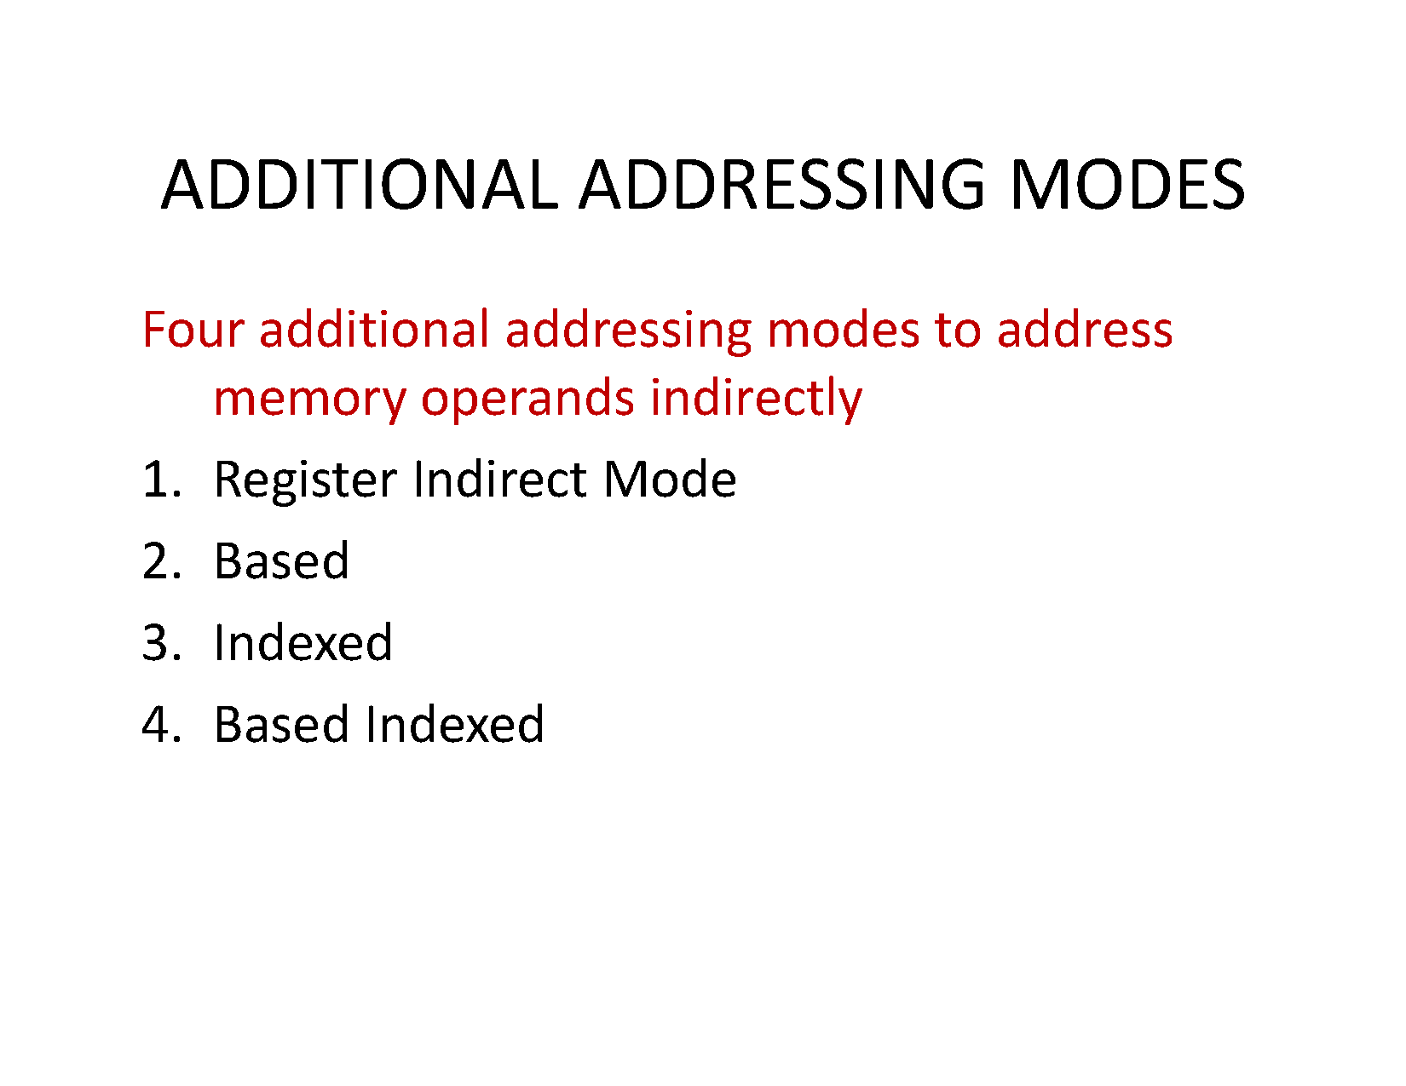

Slide 15
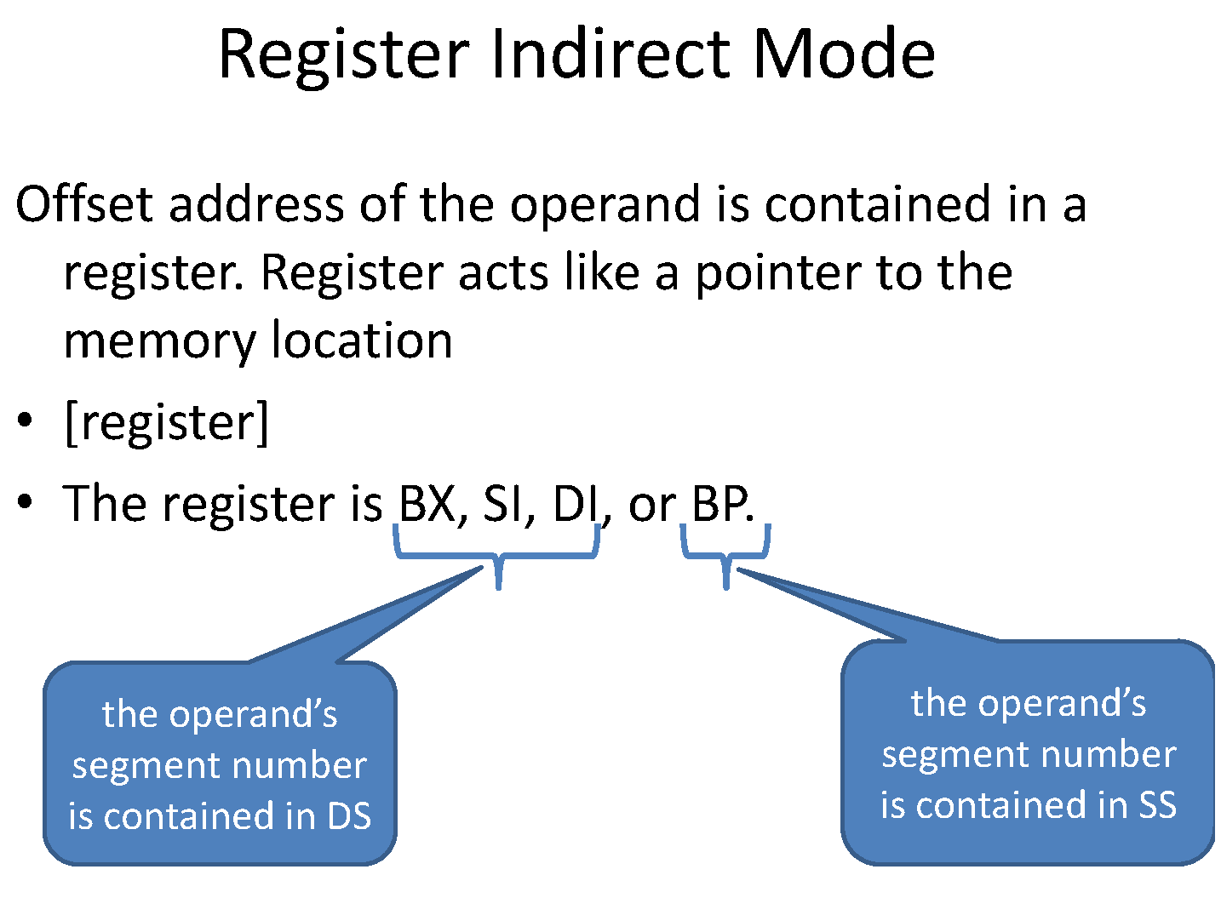

Slide 16
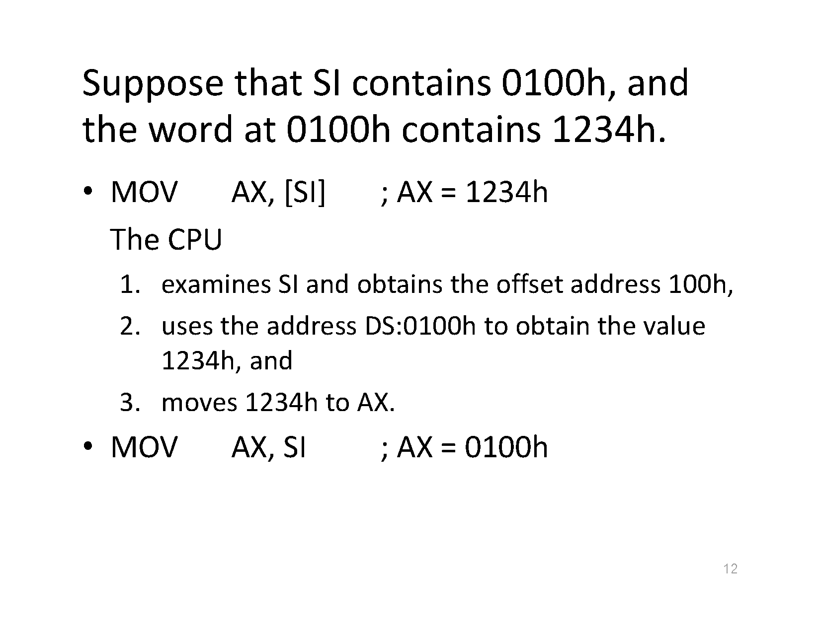

Slide 17
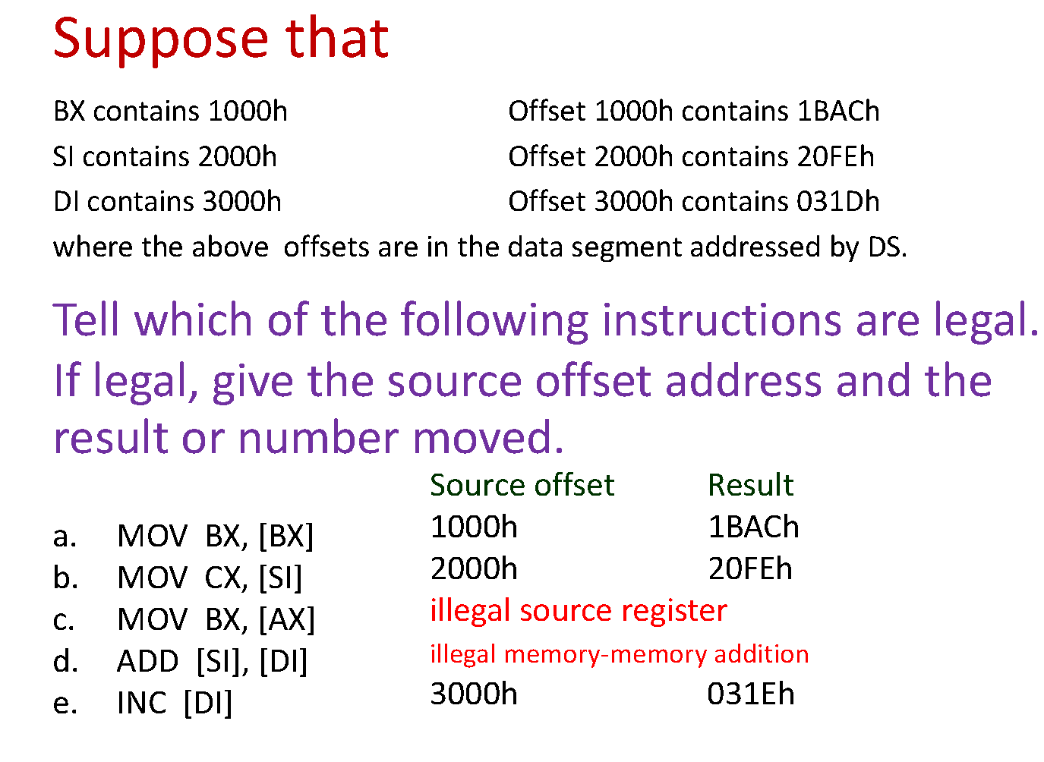

Slide 18
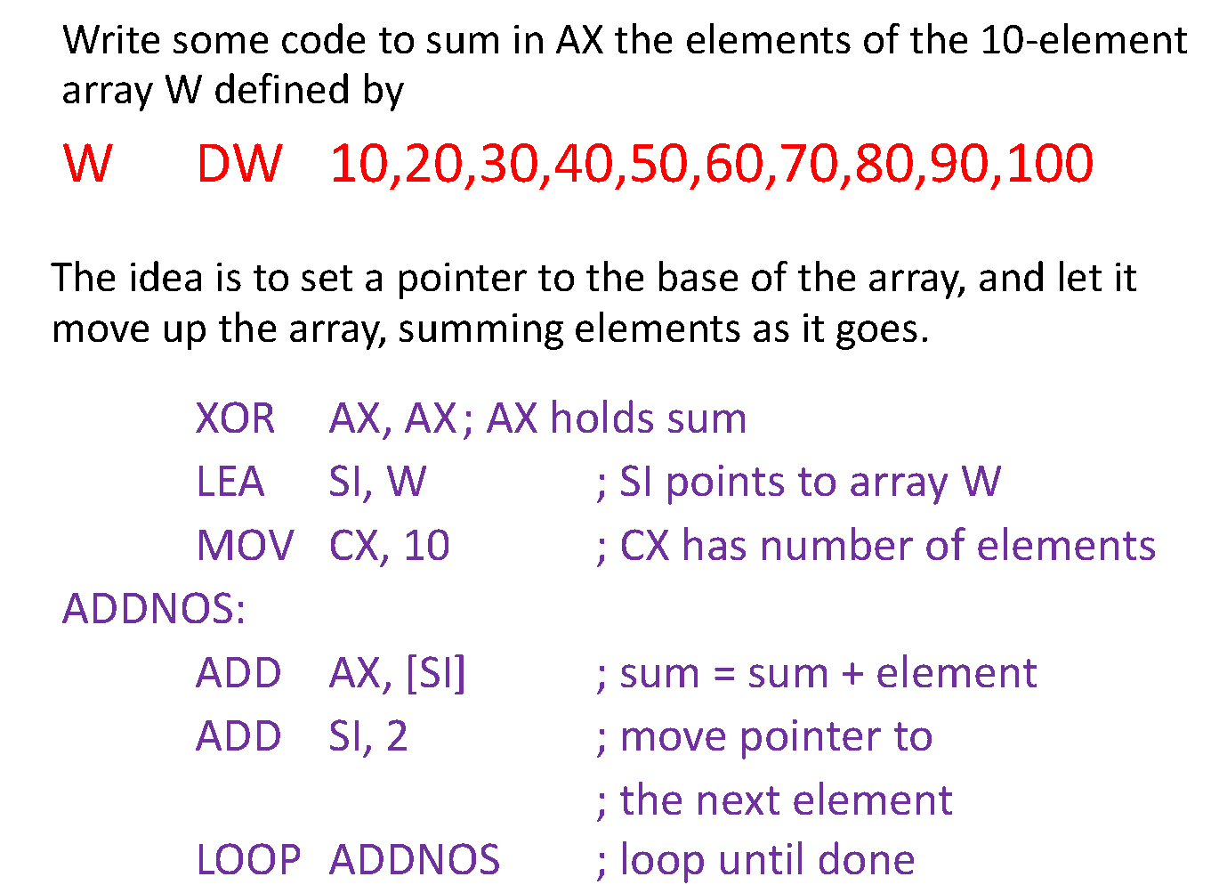

Slide 19
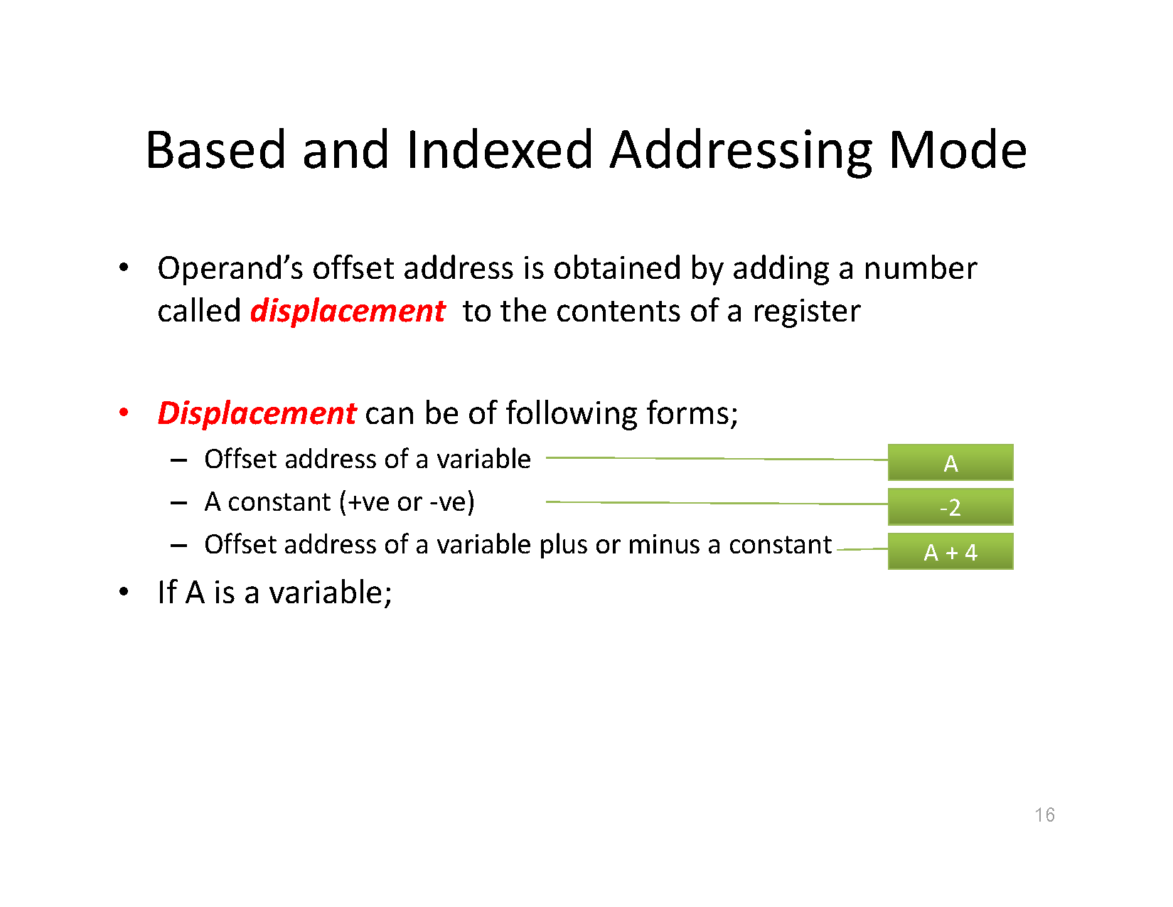

Slide 20
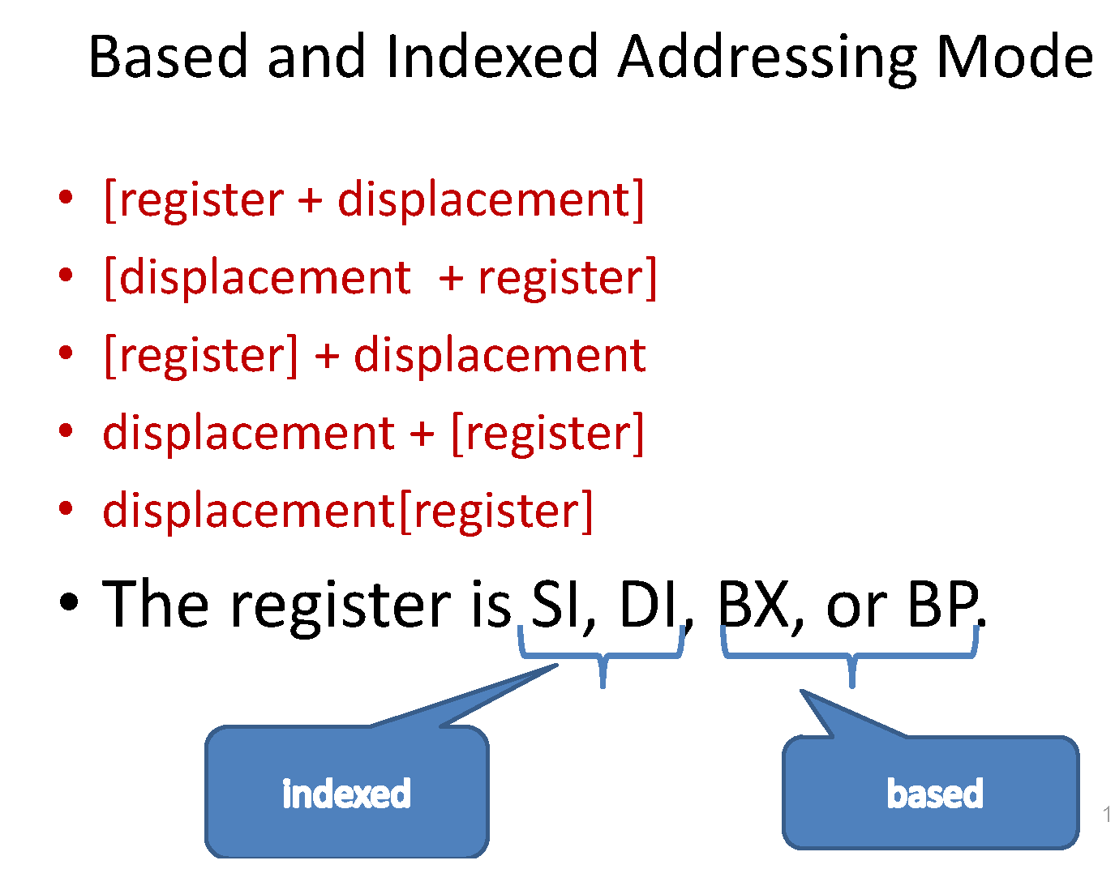

Slide 21
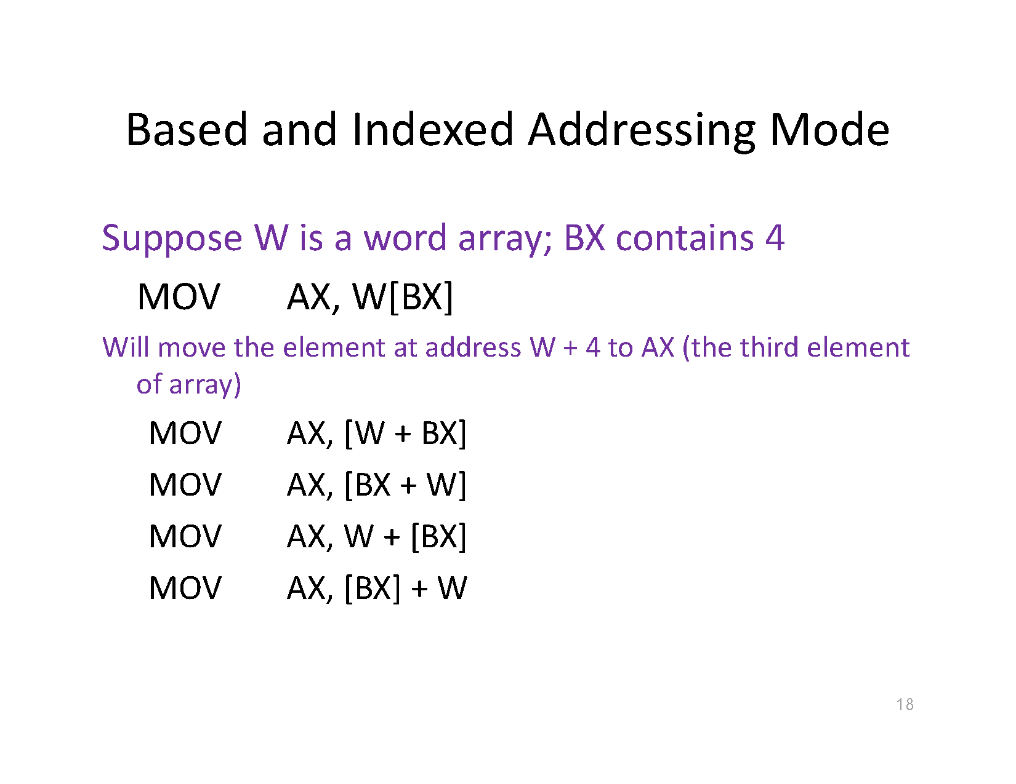

Slide 22
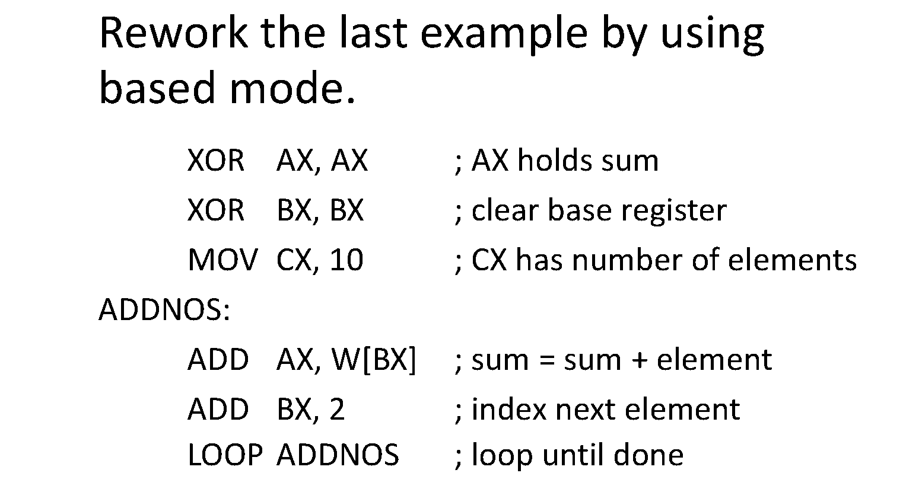
Example:
Write some code to sum in AX the elements of the 10-element array W defined by_
W DW 10, 20, 30, 40, 50, 60, 70, 80, 90, 100

Slide 23
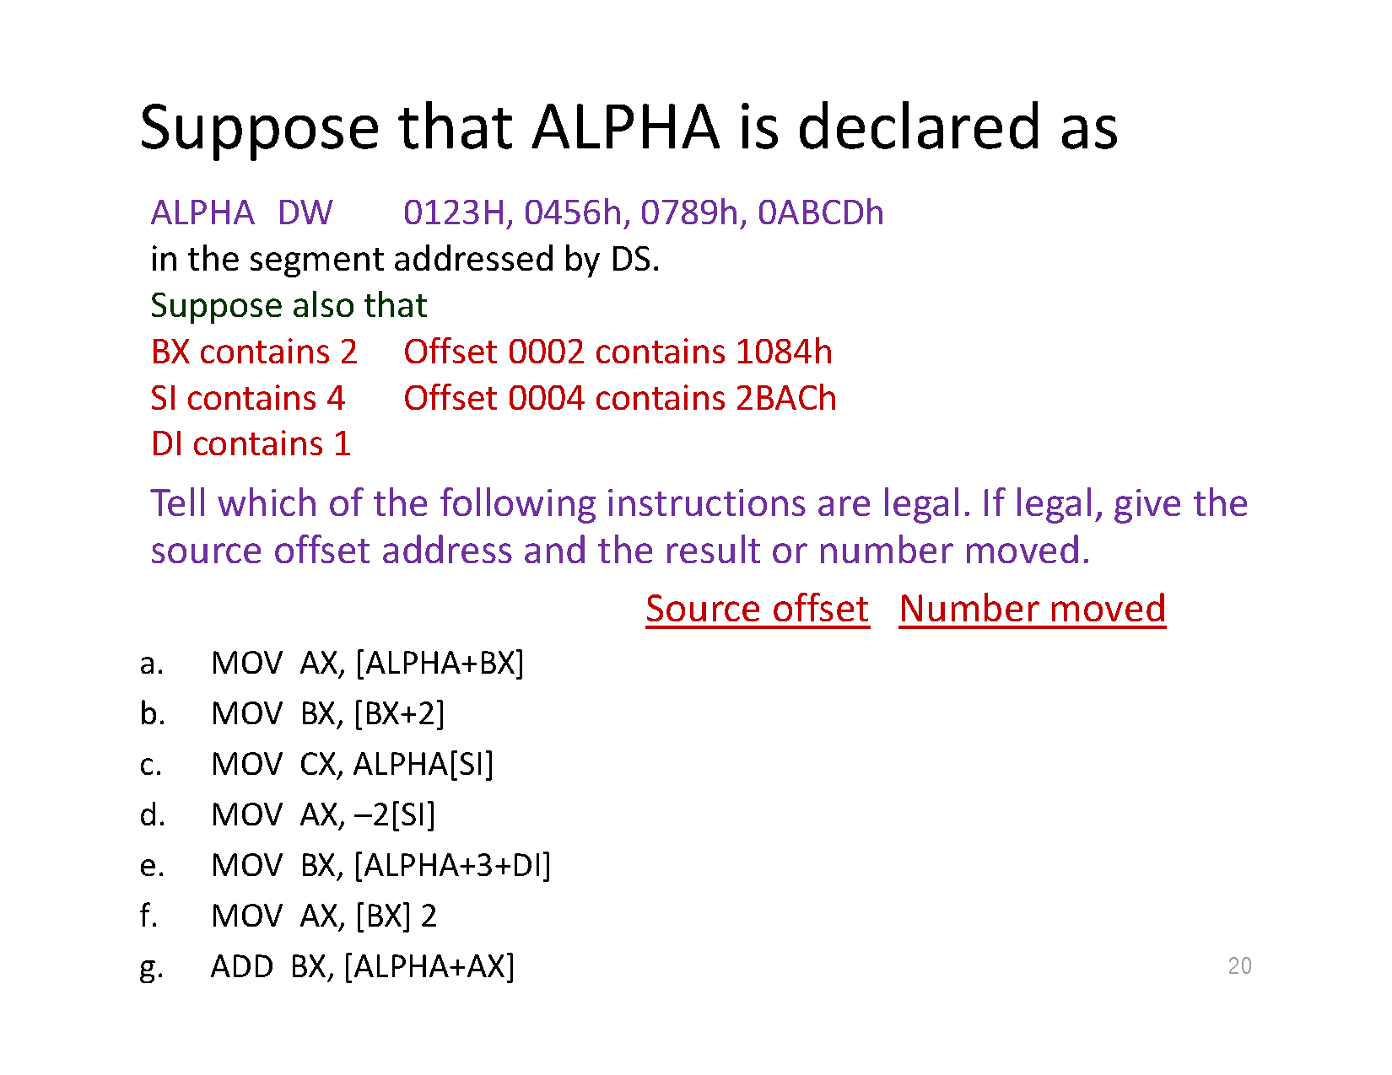

Slide 24
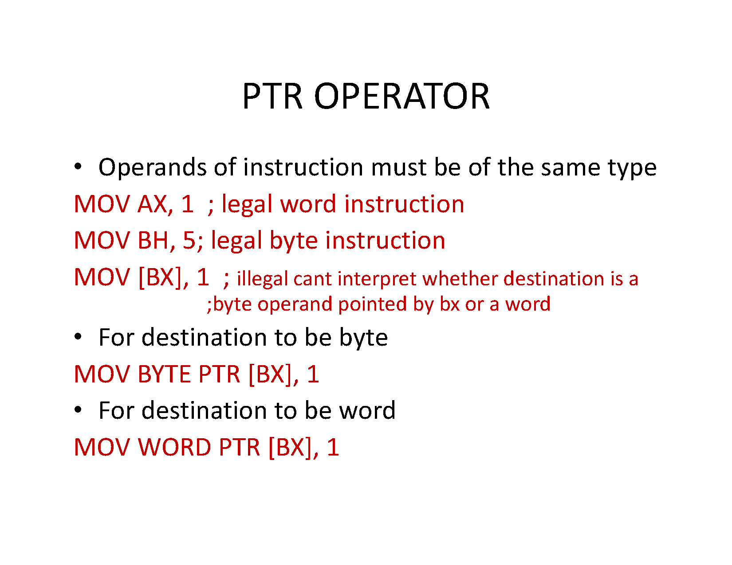

Slide 25
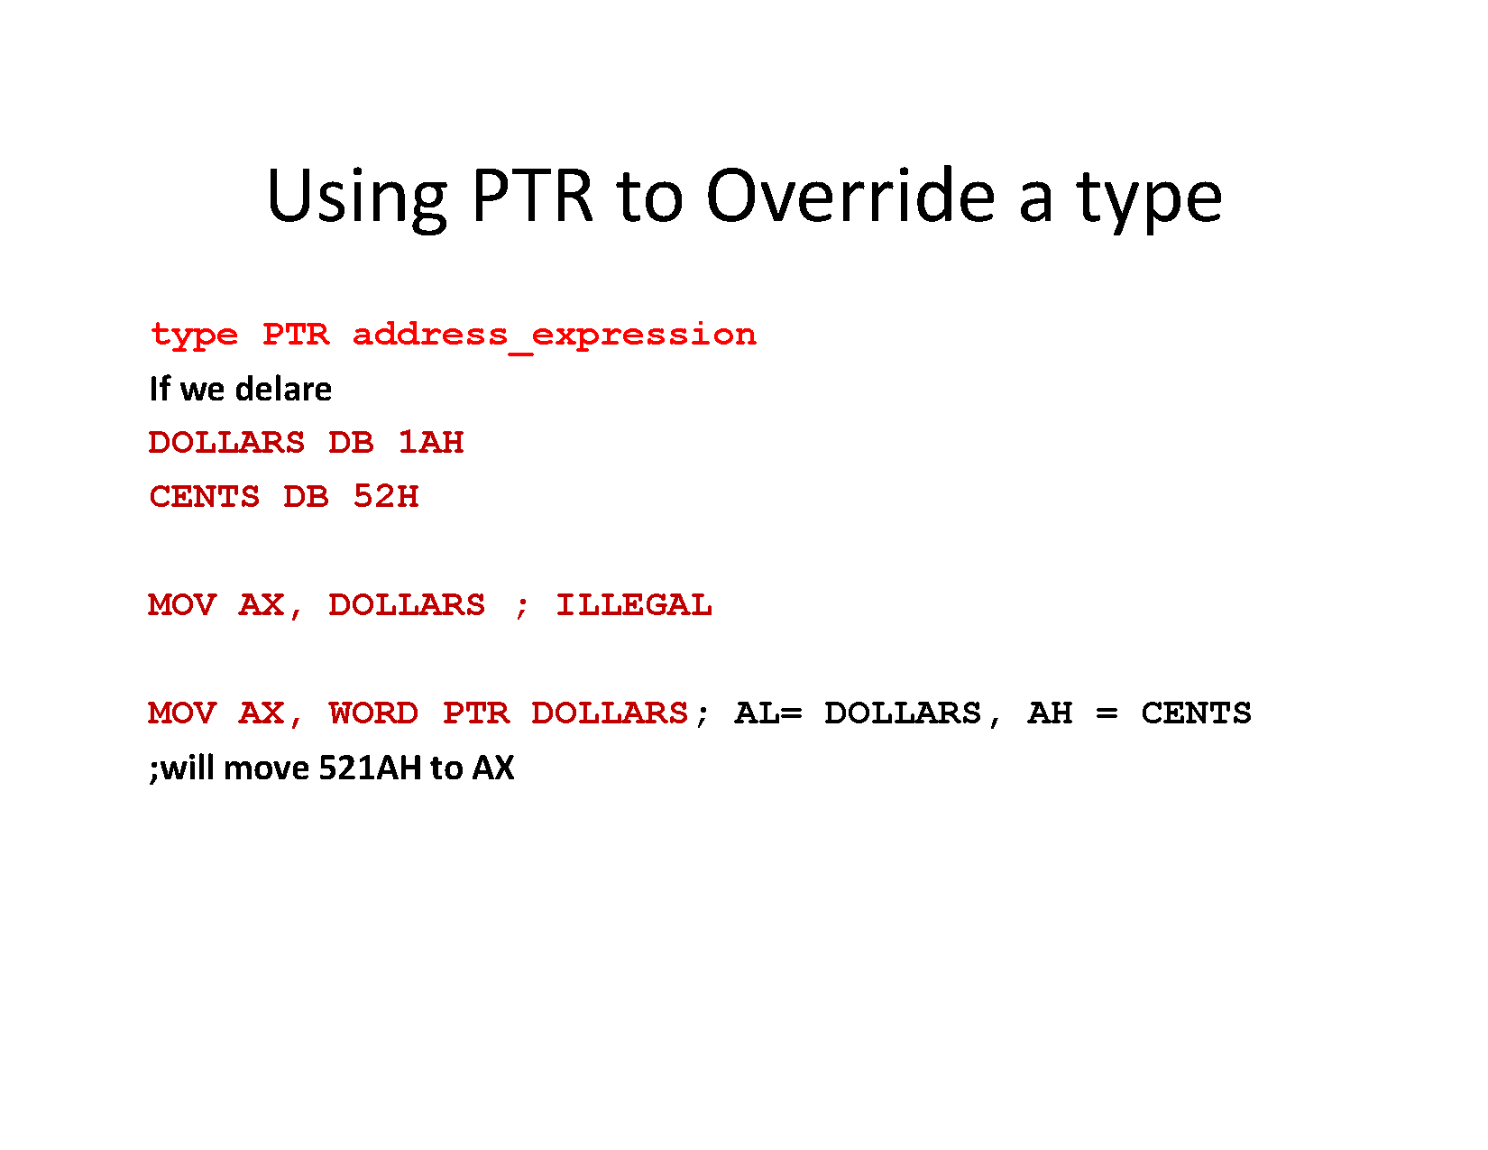

Slide 26
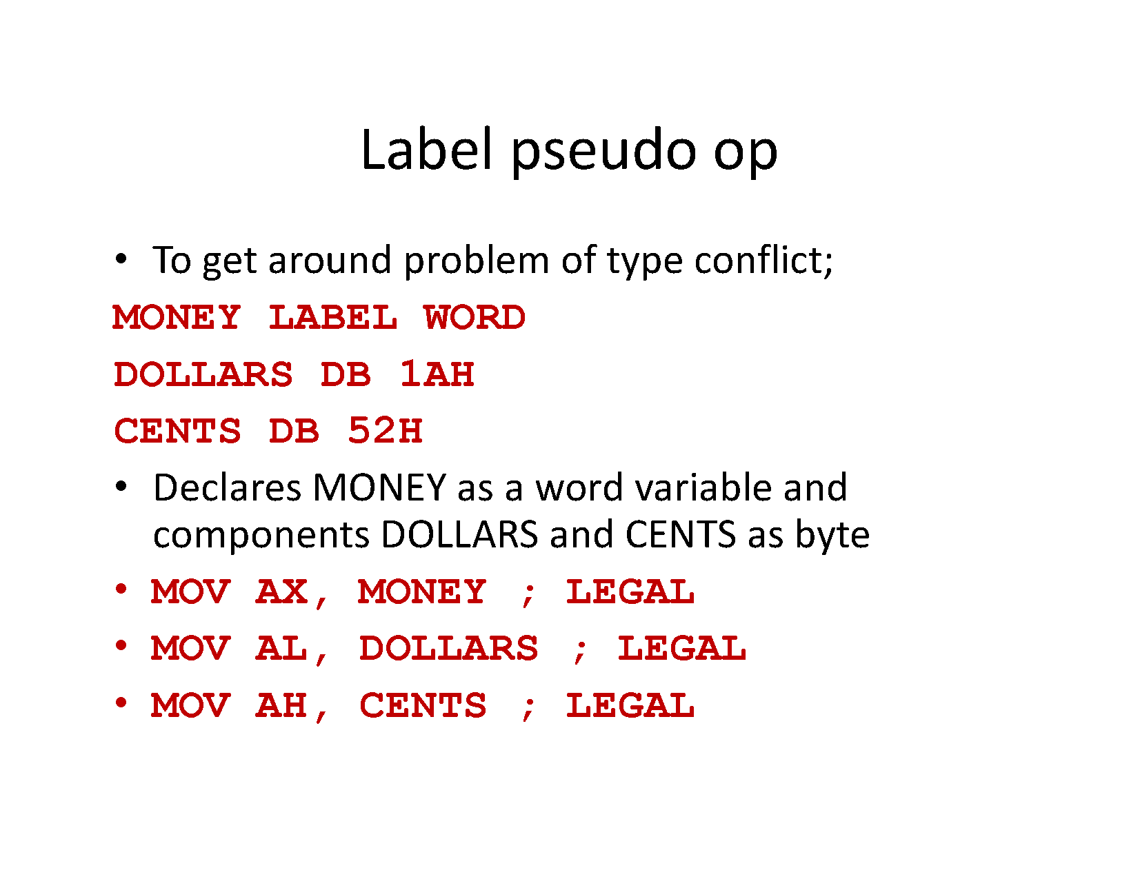

Slide 27
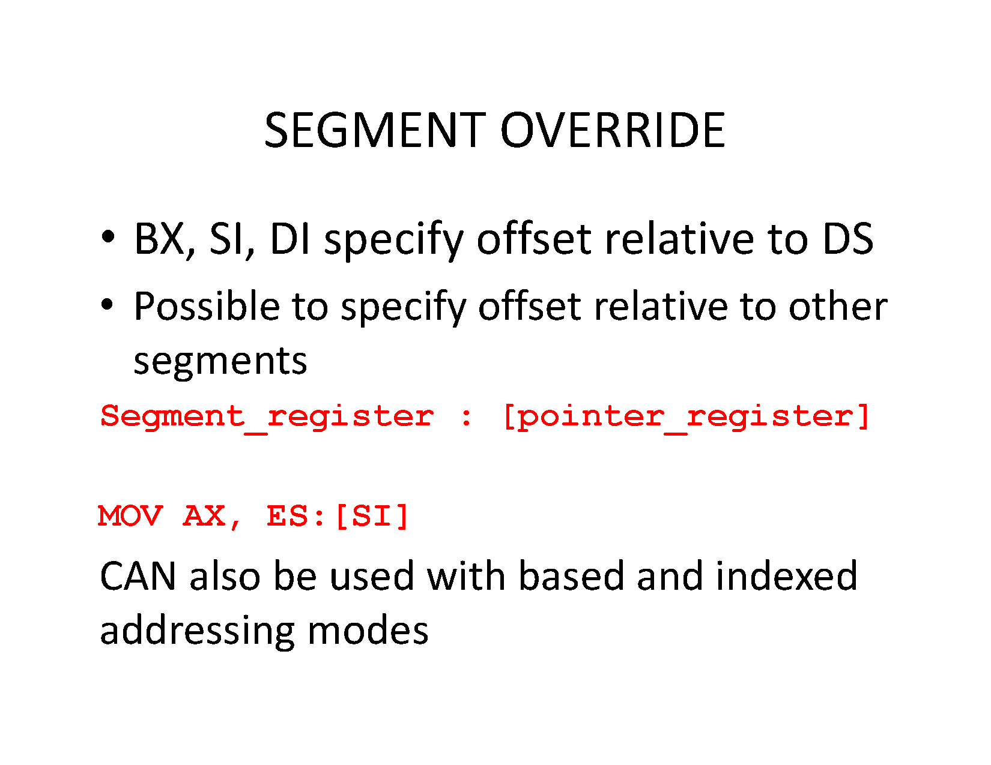

Slide 28
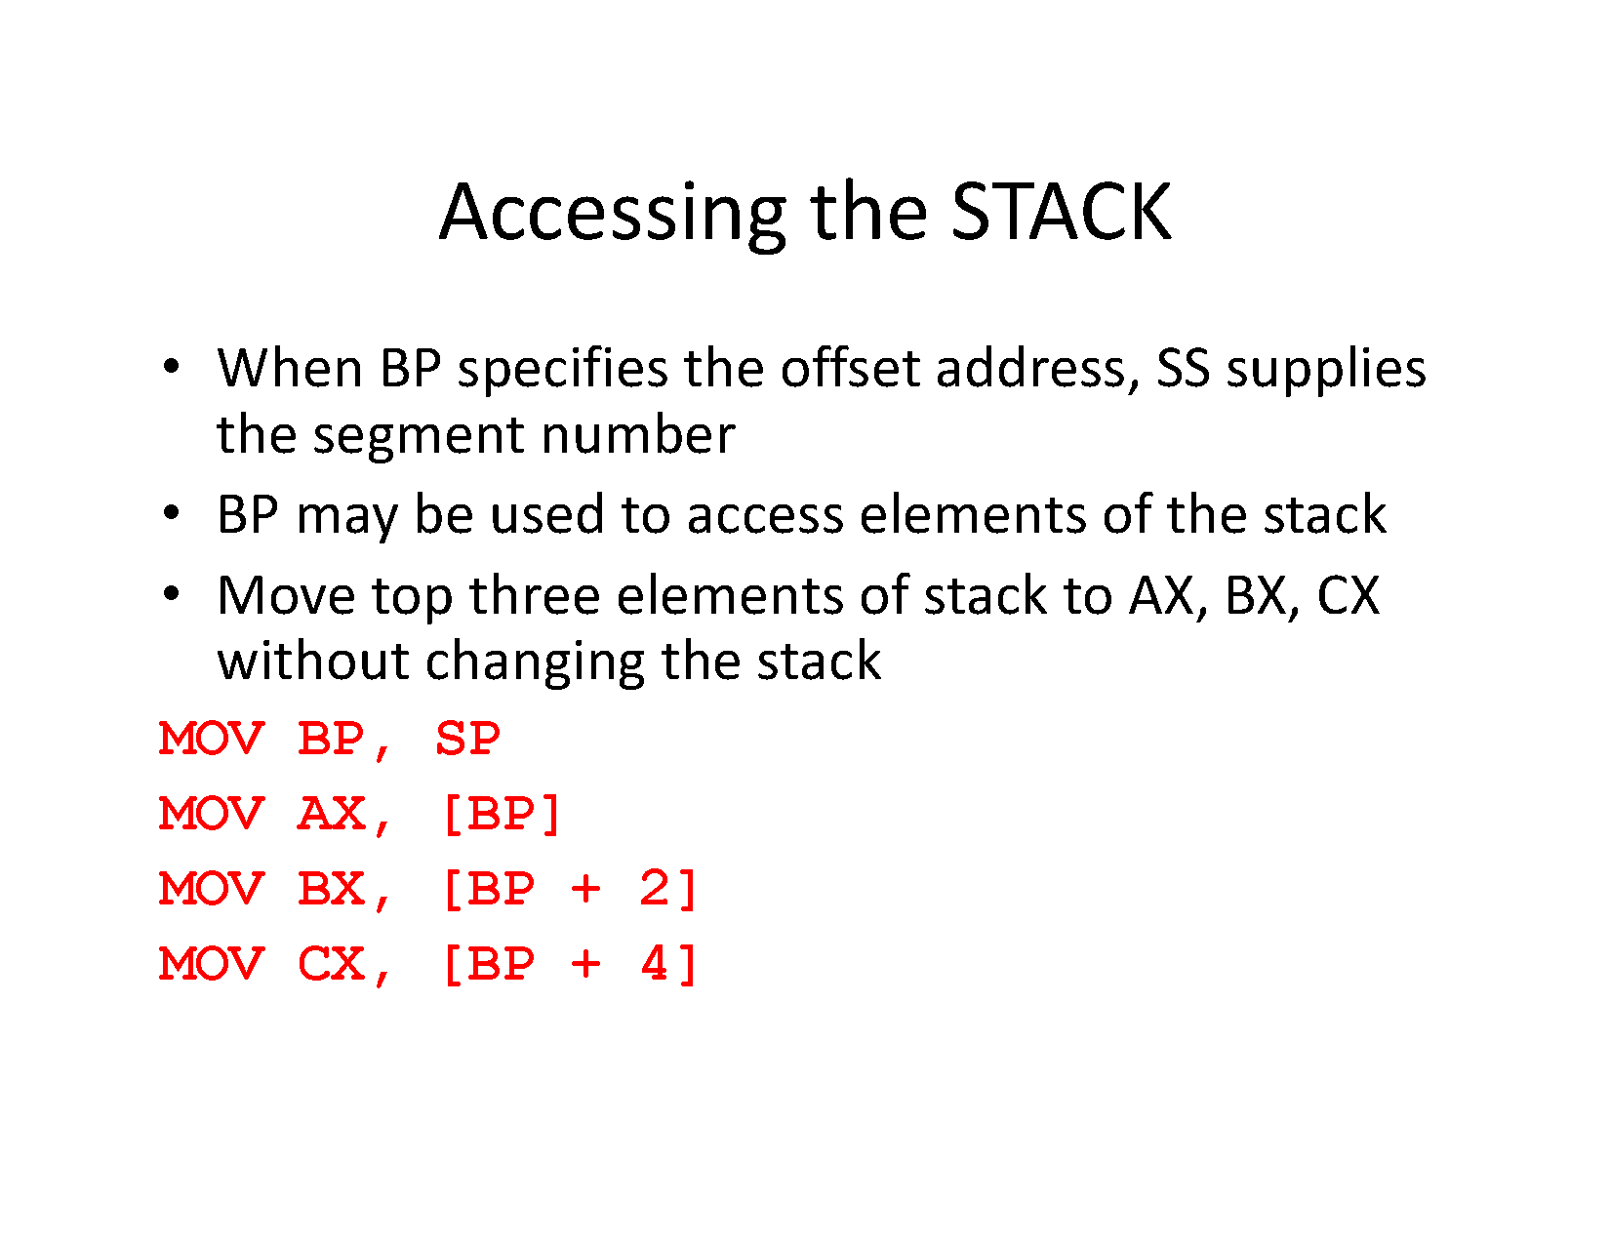

Slide 29
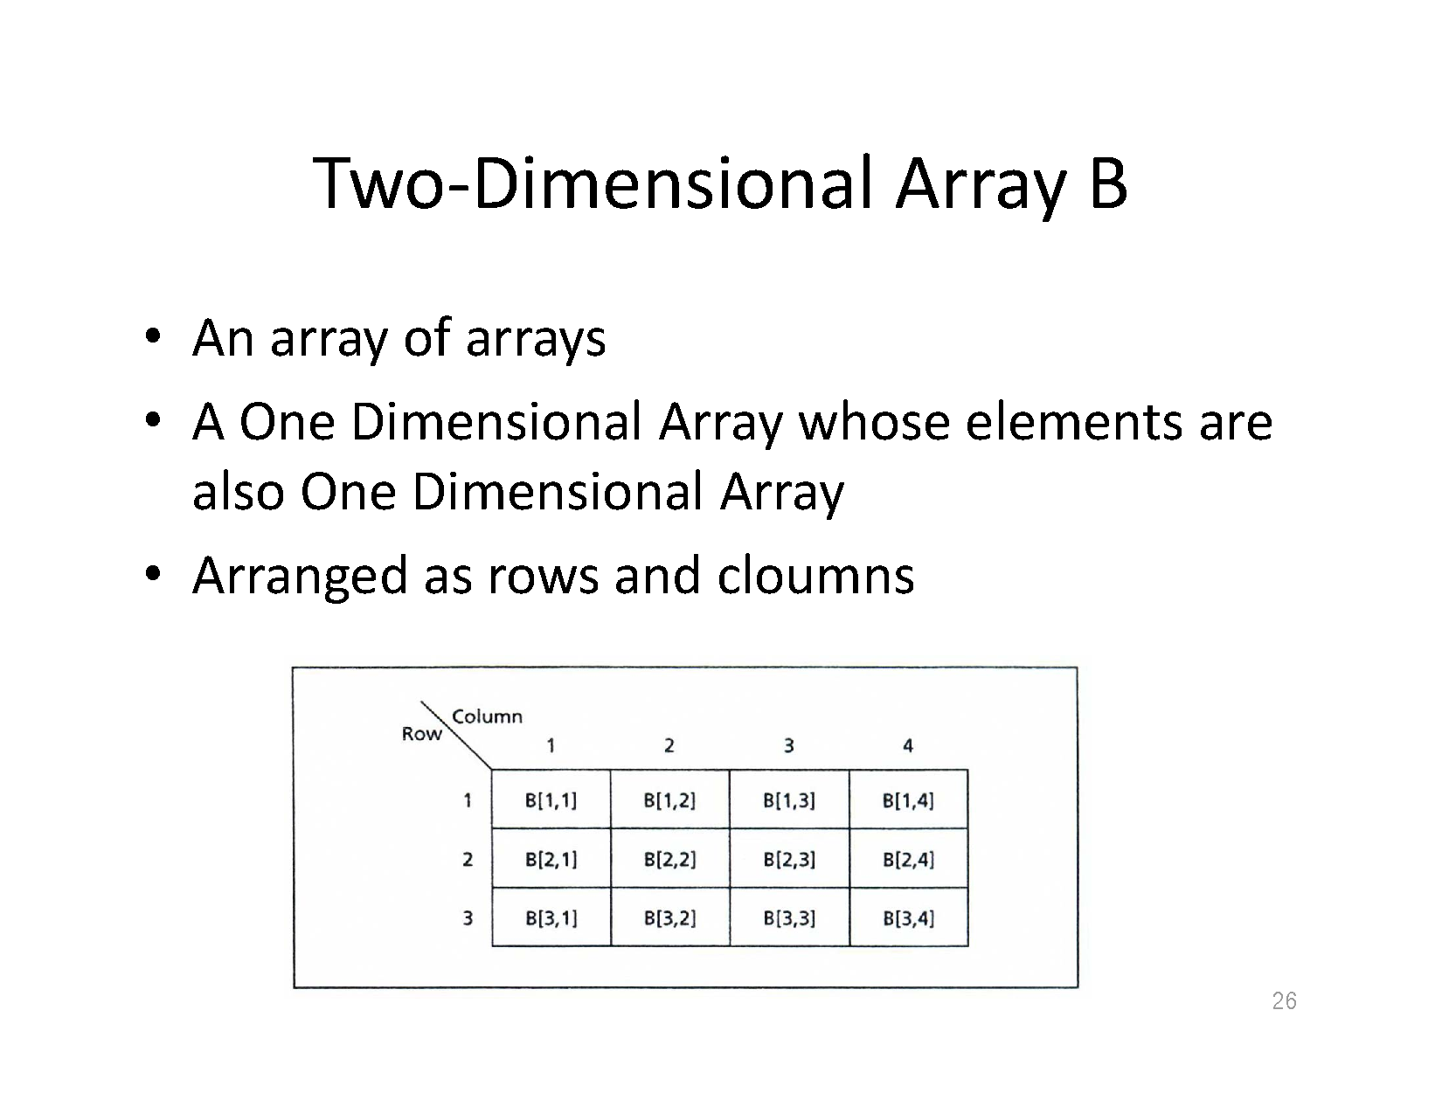

Slide 30
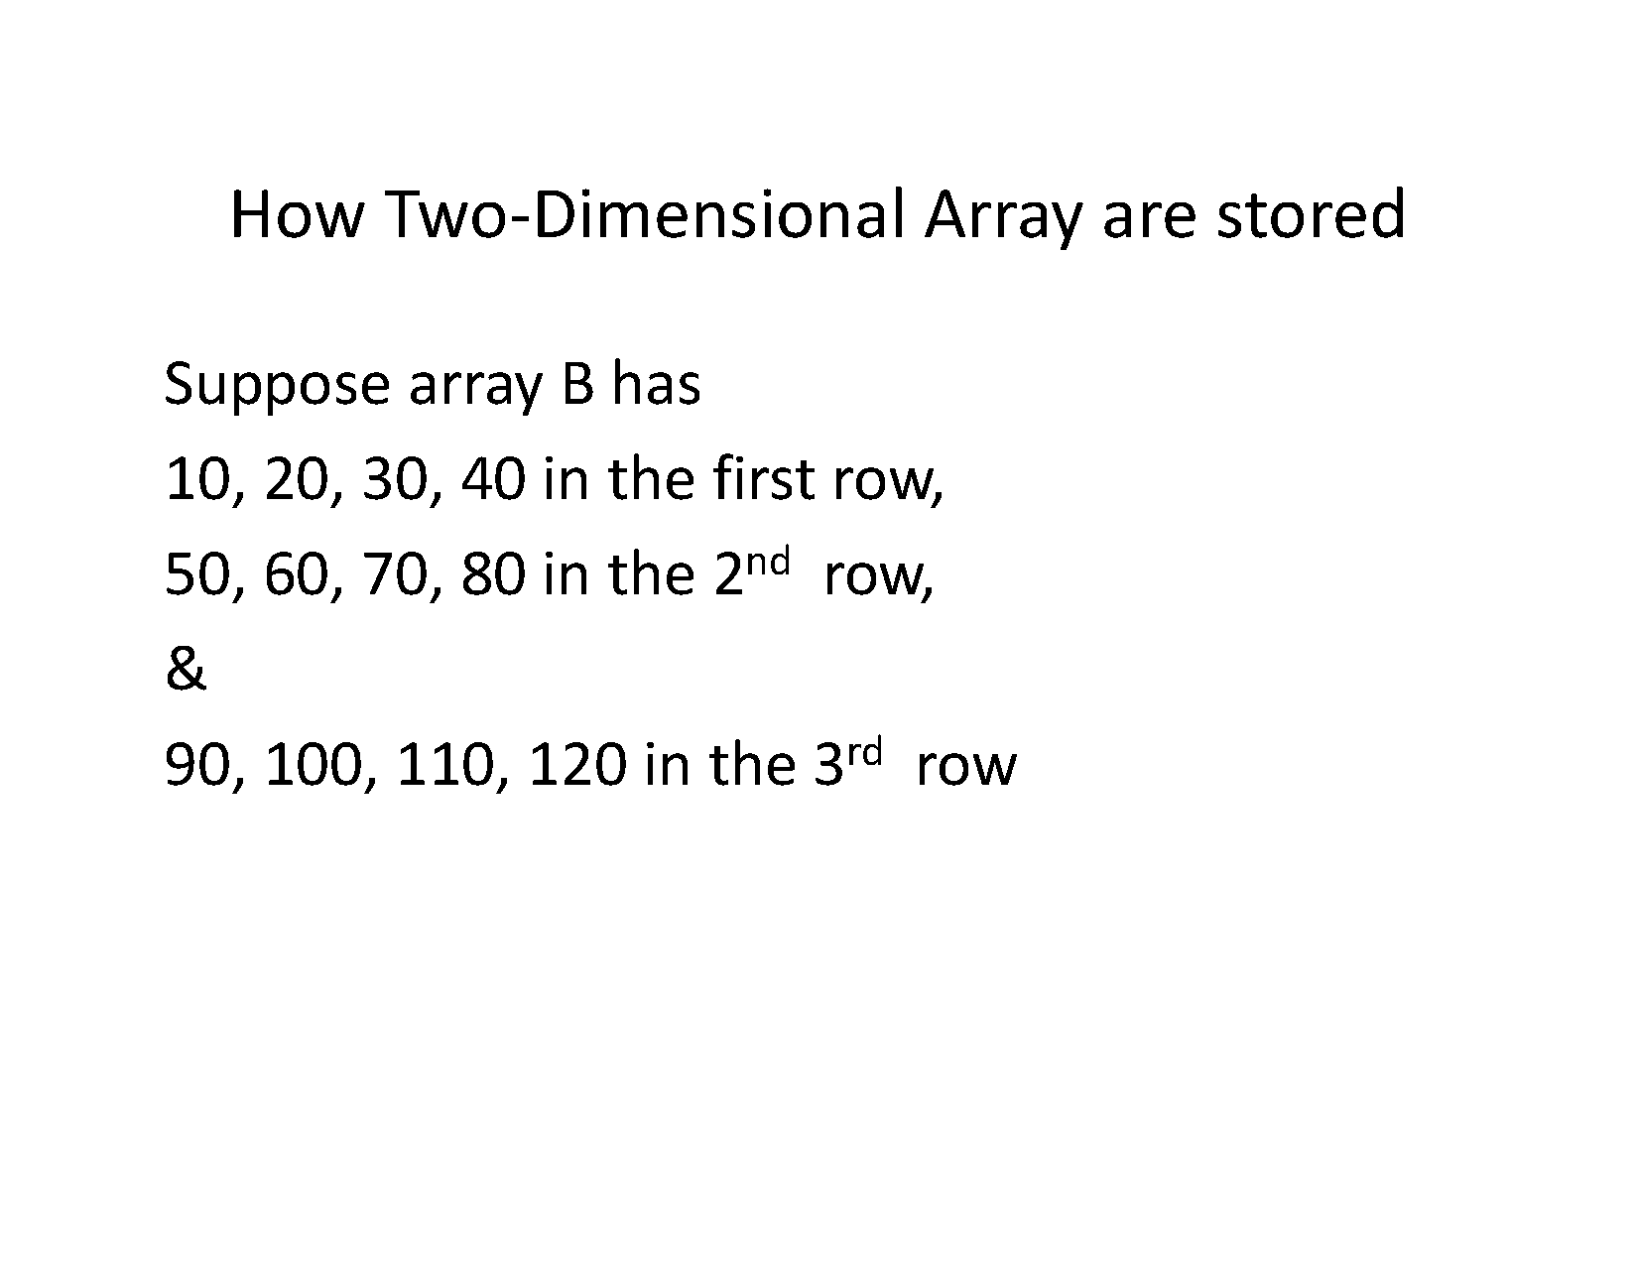

Slide 31
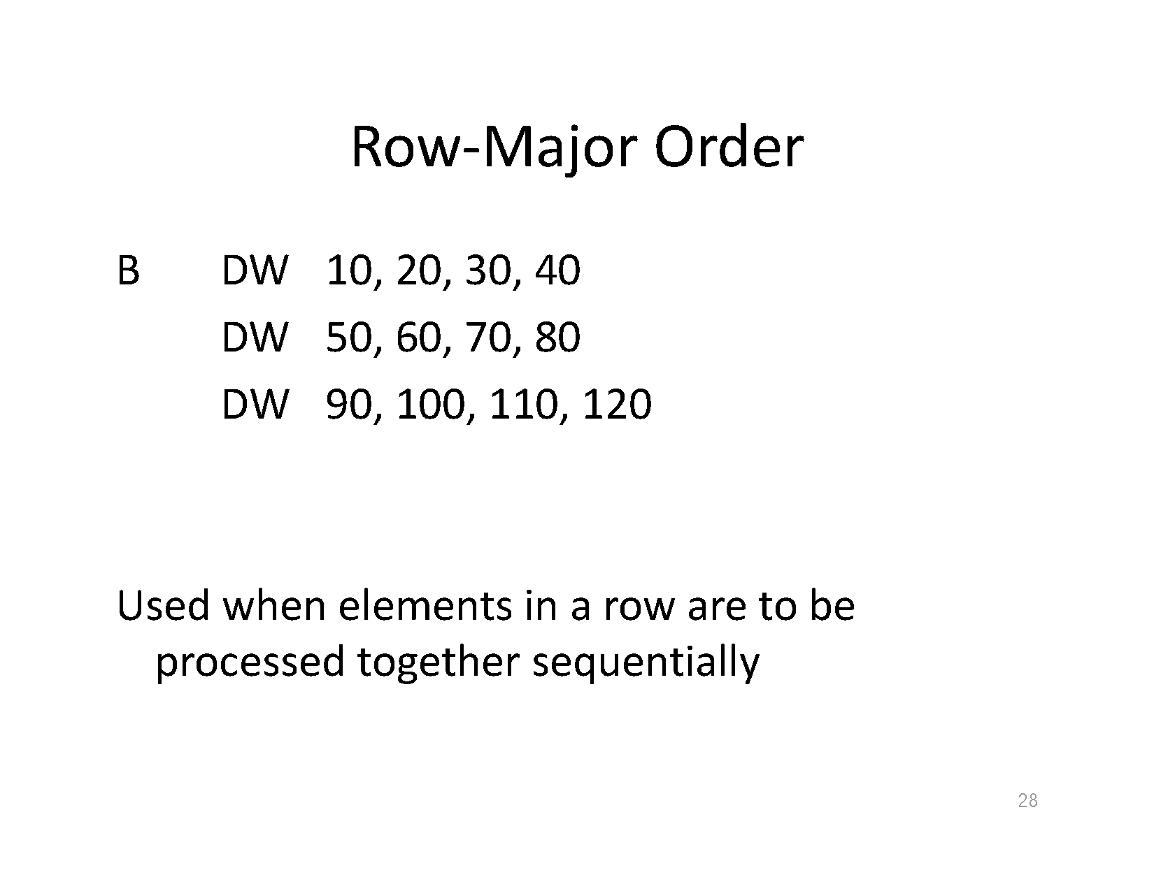

Slide 32
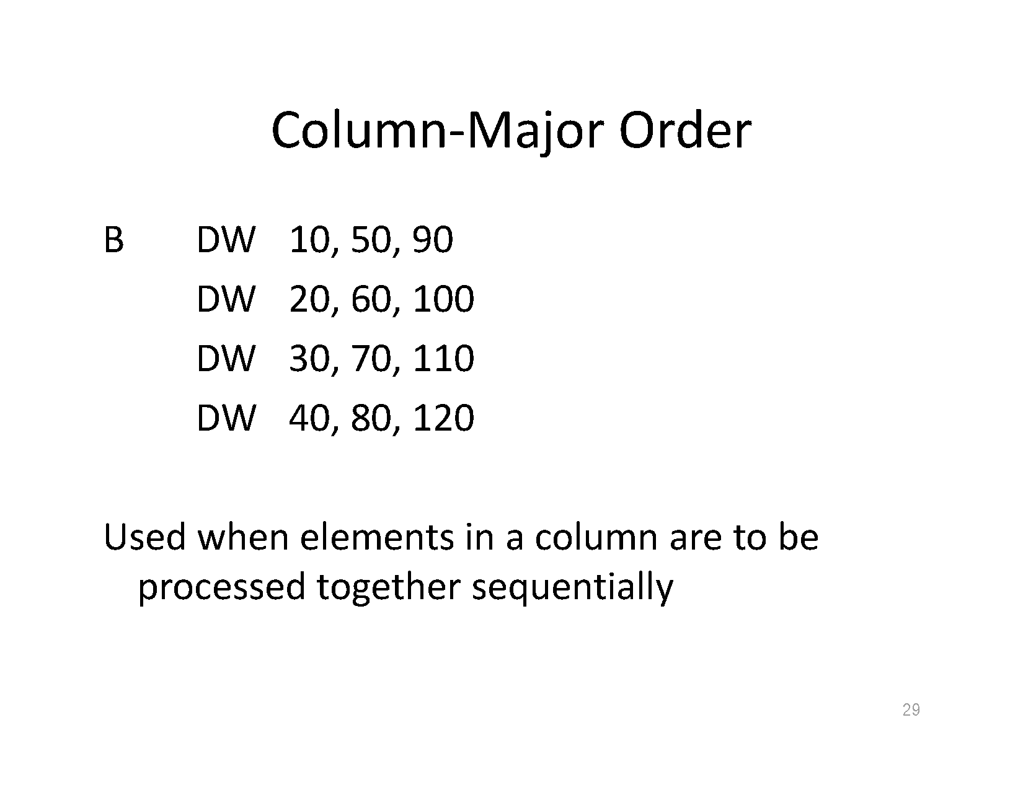

Slide 33
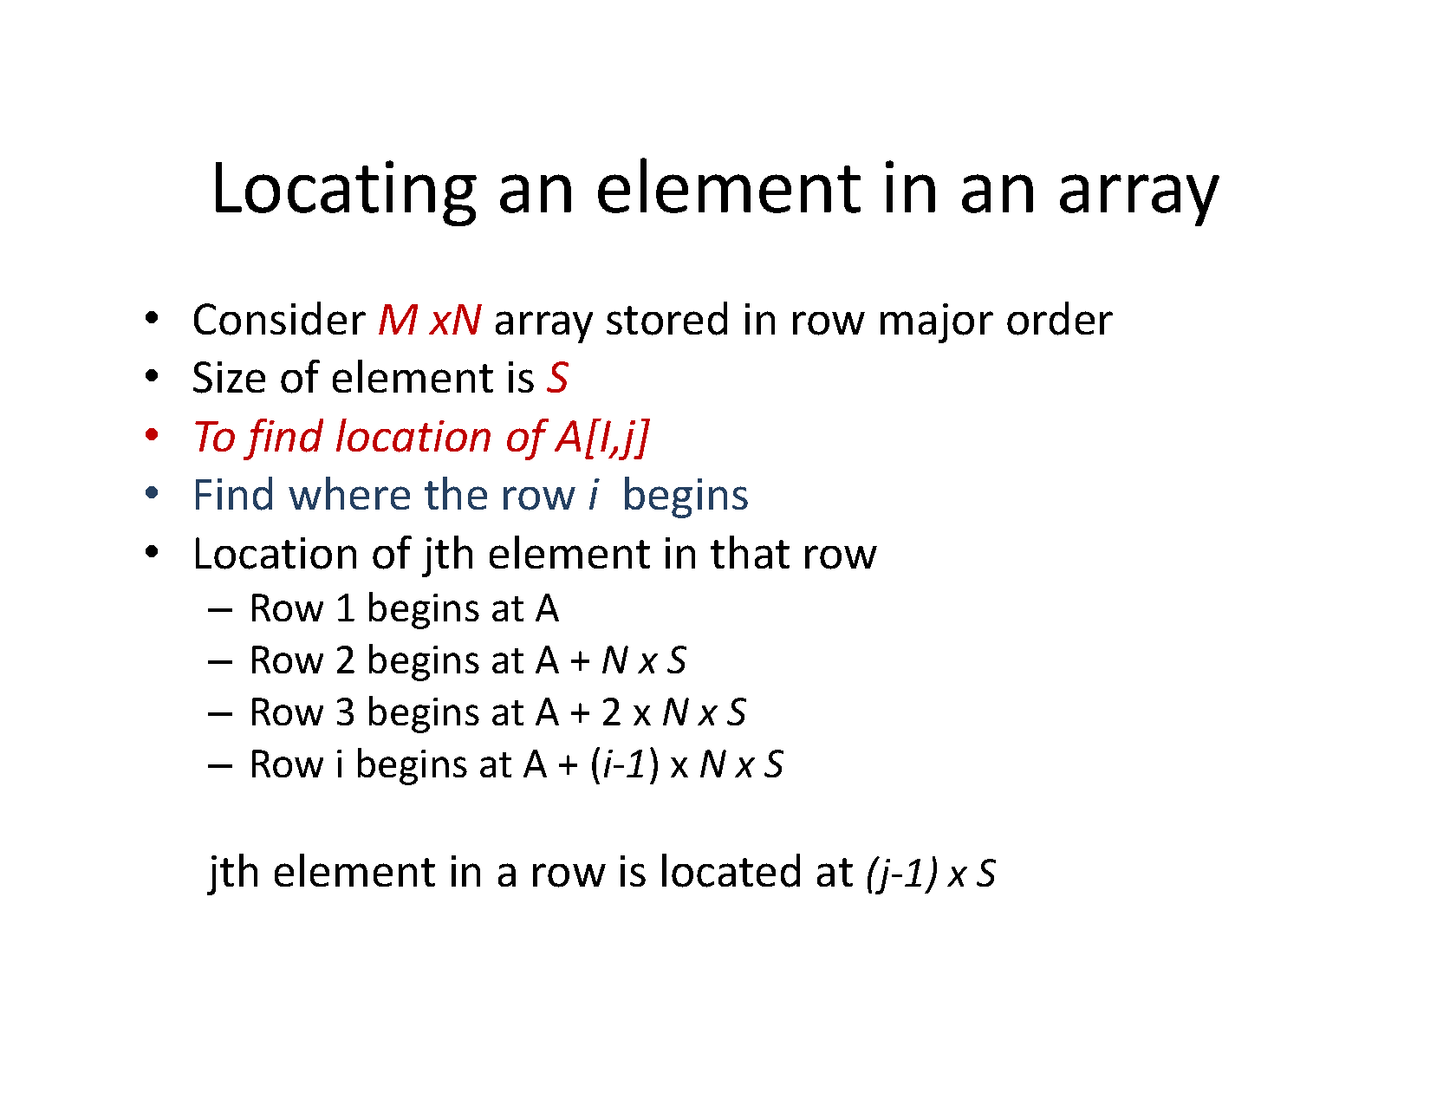

Slide 34
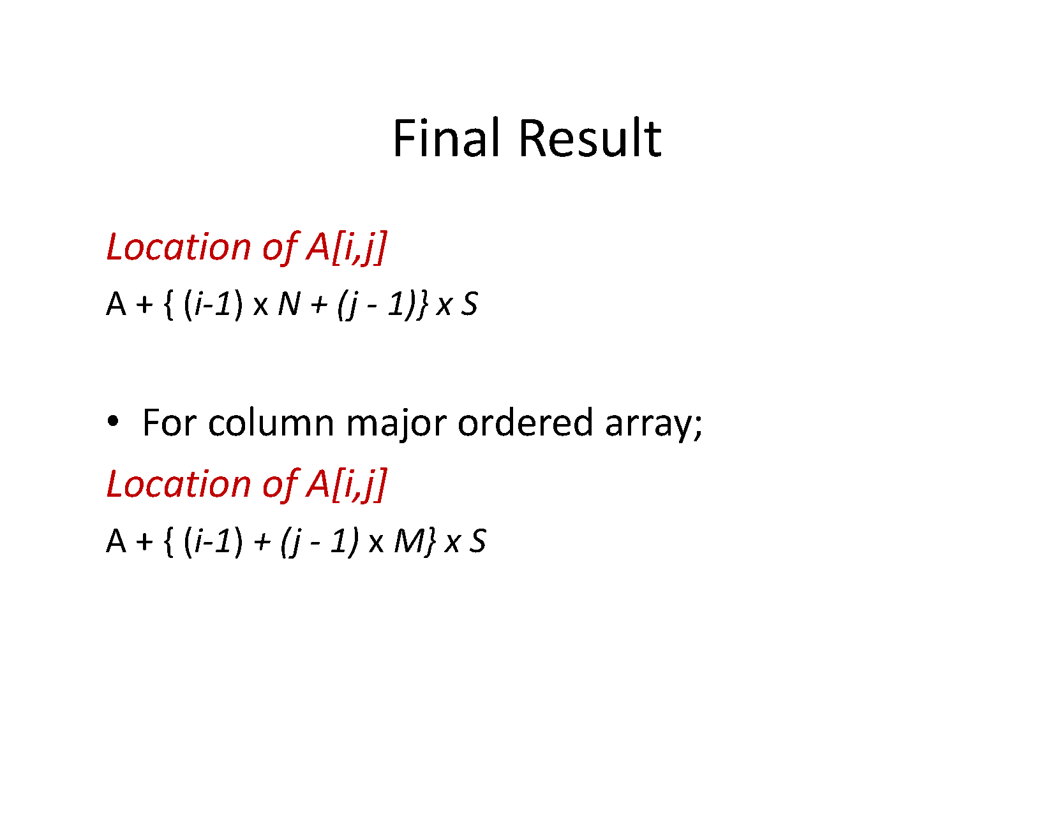

Slide 35
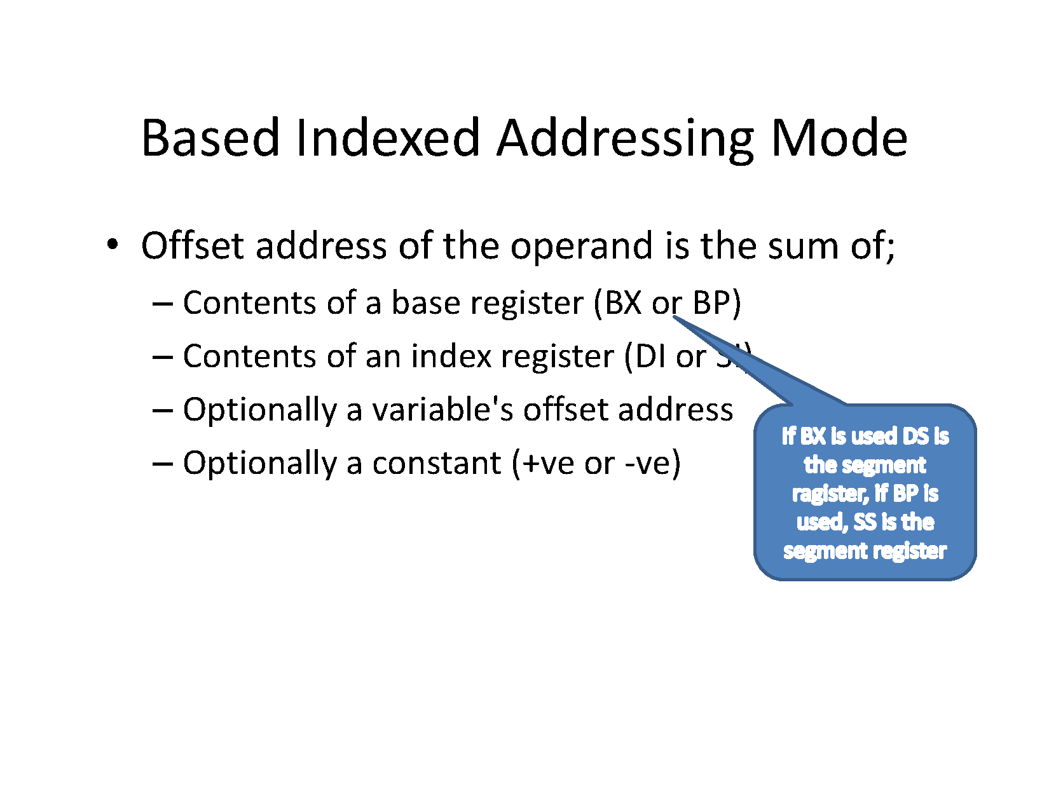

Slide 36
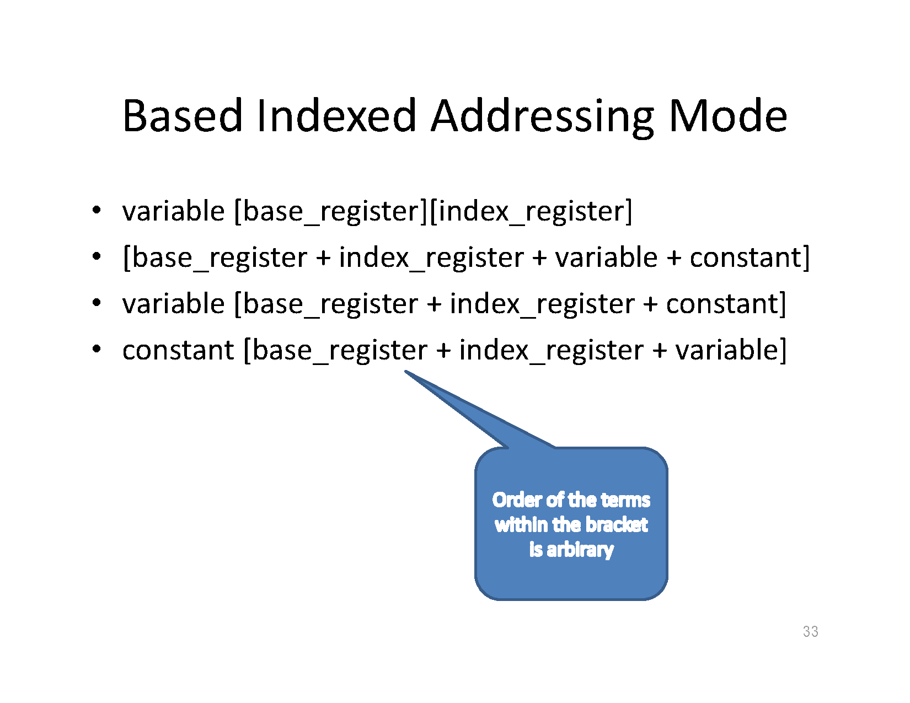

Slide 37
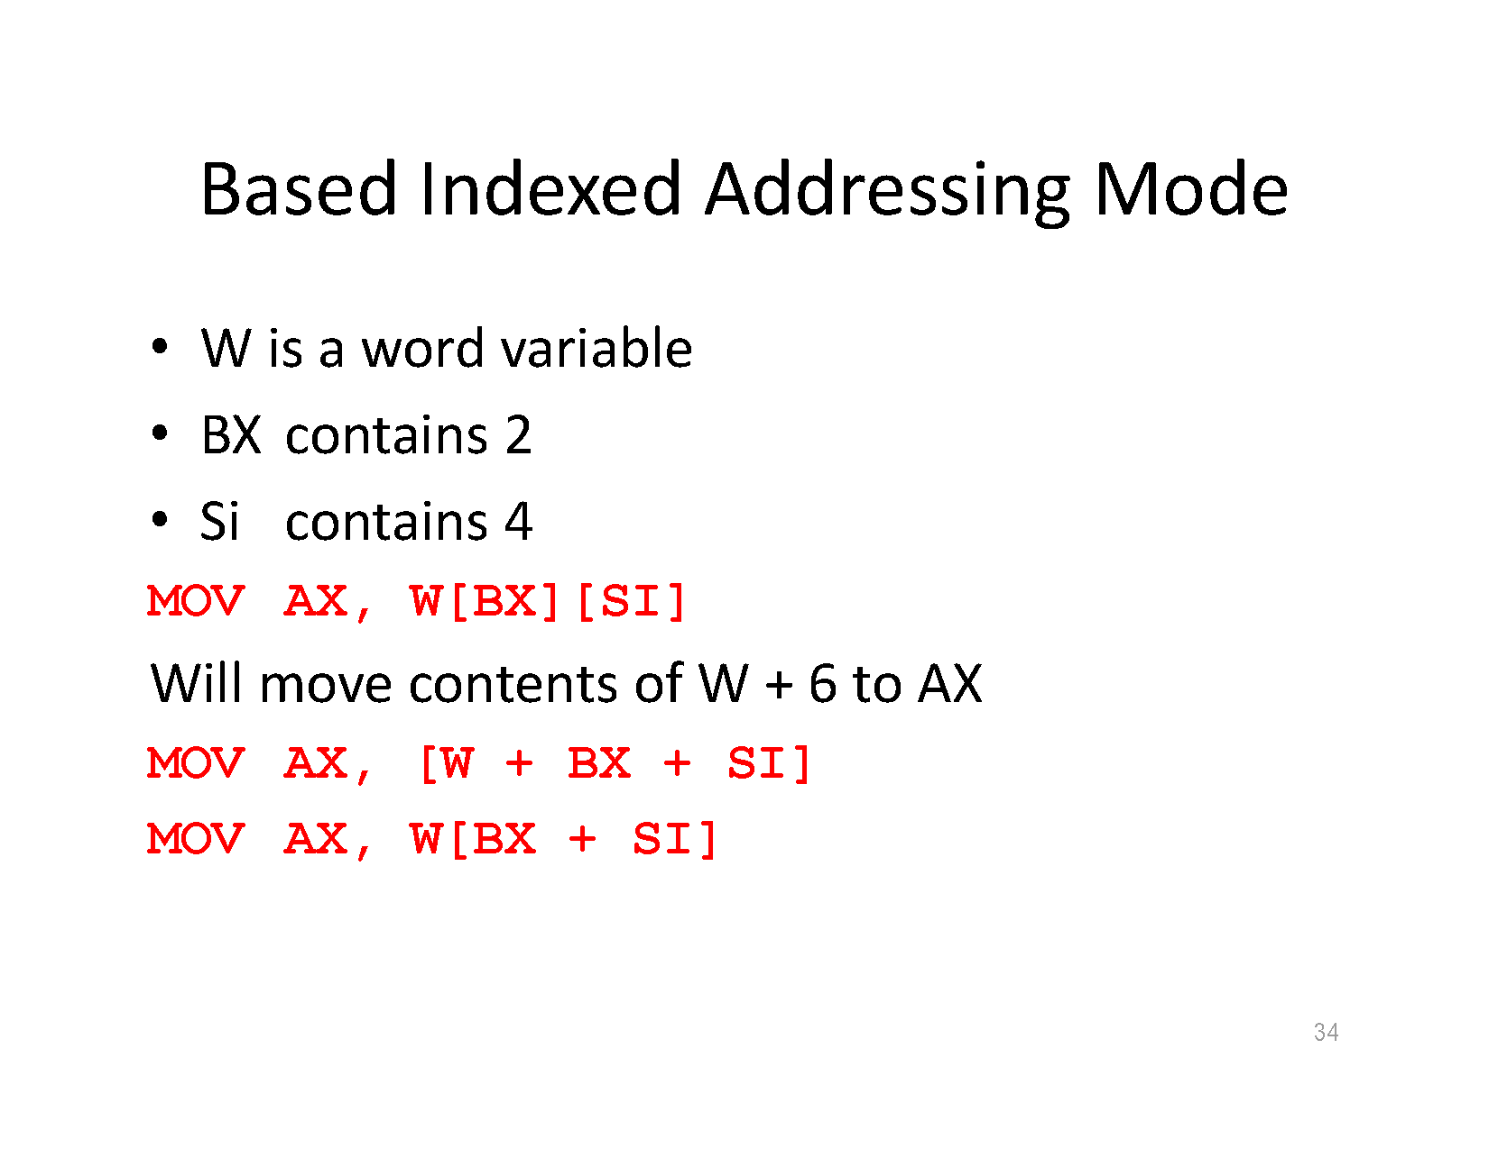

Slide 38
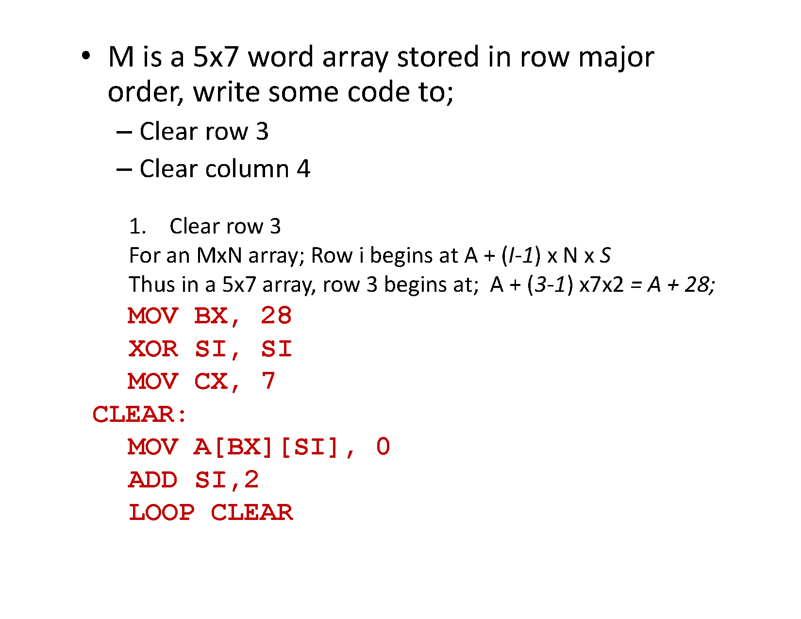

Slide 39
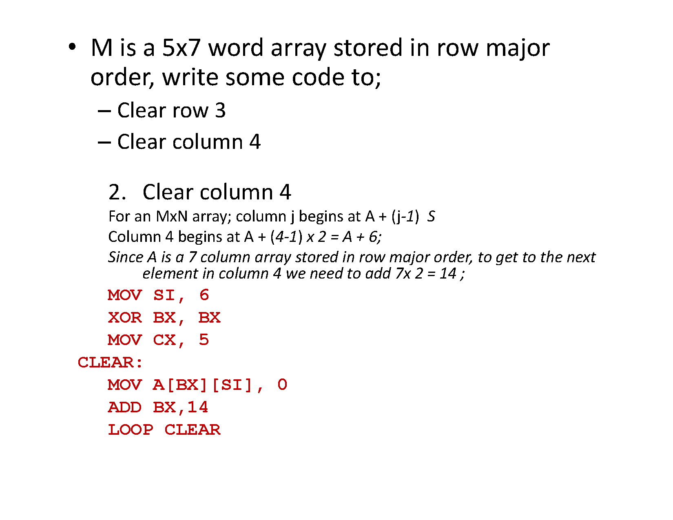

Slide 40
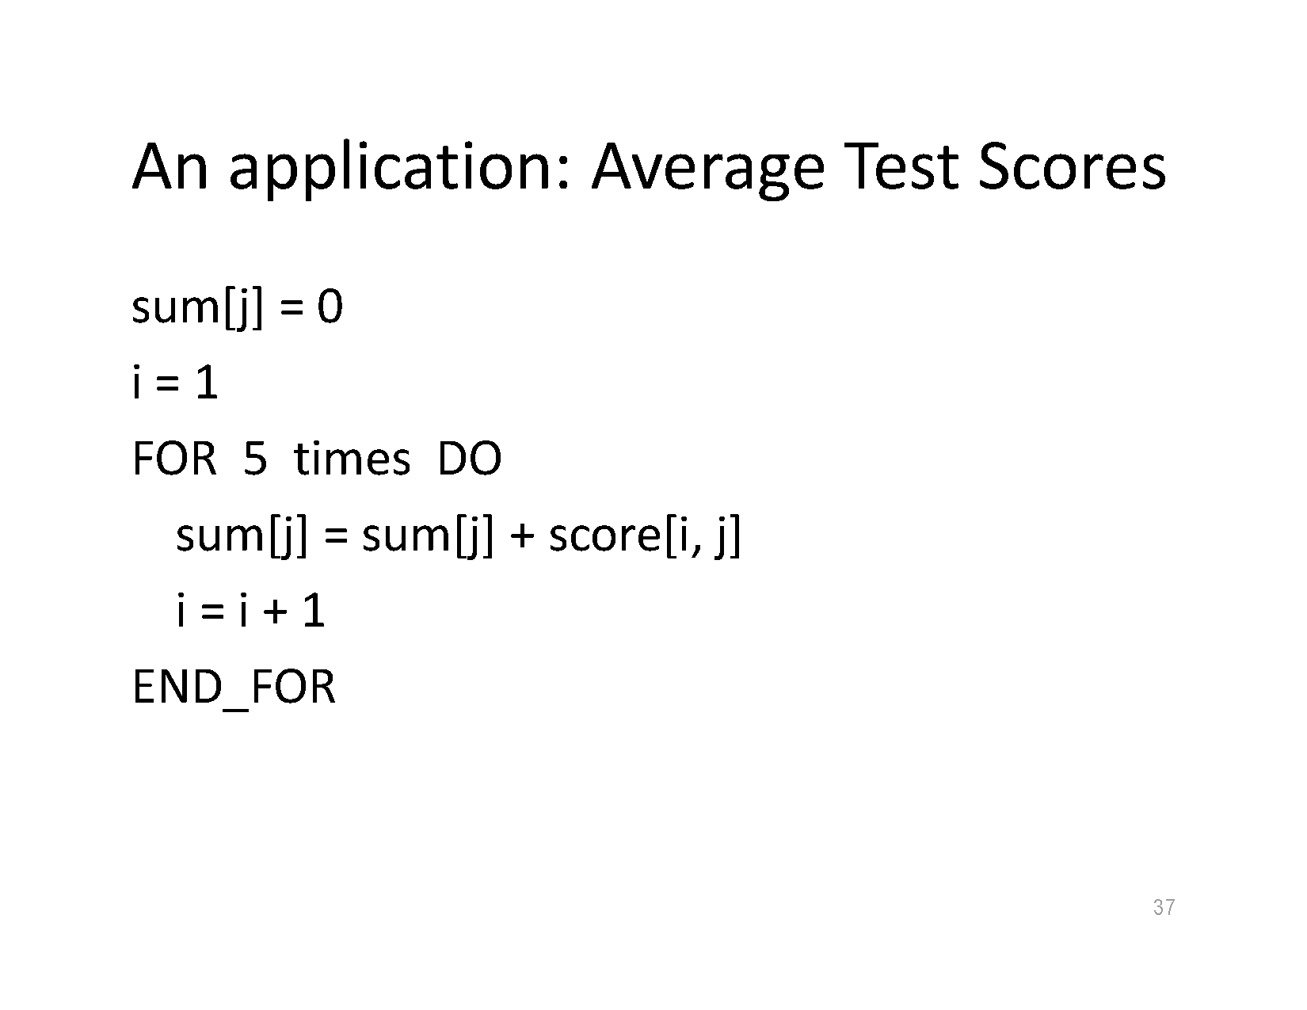

Slide 41
The XLAT instruction
1.What does XLAT instruction do?
2. Why do we use it?(applications).

Slide 42
The XLAT Instruction
In some applications, it is necessary to translate data from one form
to another.
For example., the IBM PC uses ASCII codes for characters, but IBM mainframes use EBCDIC (Extended Binary Coded Decimal Interchange Code).
To translate a character string encoded In ASCII to EBCDIC, a program must replace the ASCII code of each character In the string with the corresponding EBCDIC code.

Slide 43
XLAT
The instruction XLAT (translate) is a no-operand instruction that can be used to convert a byte value Into another value that comes from a table.
The byte to be converted must be in AL, and BX has the offset address of the conversion table.
The instruction
First load the offset part of the start address of the table into BX register.
Then load al with the position of the byte you want in the table and invoke the XLAT instruction.
The byte stored at the specified position in the table will be in AL register after the instruction executes.

Slide 44
Example: Suppose that a 7-segment LED display lookup table is stored in memory at address TABLE. The XLAT instruction then uses the lookup table to translate the BCD number in AL to a 7-segment code in AL.
TABLE DB 3FH, 06H, 5BH, 4FH ;lookup table
DB 66H, 6DH, 7DH, 27H
DB 7FH, 6FH
LOOK: MOV AL,5 ;load AL with 5 (a test number)
MOV BX,OFFSET TABLE ;address lookup table
XLAT ;convert

Slide 45
EXAMPLE: A TABLE OF ASCII CODES FOR HEXADECIMAL DIGITS (an alternative to computing the ASCII codes as we've done in the past);;
DATA SEGMENT
HA_TABLE DB '0123456789ABCDEF’ ;This generates the table
H_DIGIT DB 7 ;Assume we want the ASCII code for a 7
ASC_DIGIT DB ? ;Store ASCII code here
DATA ENDS
CODE SEGMENT
ASSUME DS:DATA,CS:CODE
MAIN PROC FAR
;***bookkeeping instructions go here***
MOV BX,OFFSET HA_TABLE ;Offset of table
MOV AL,H_DIGIT ;Position of table entry
XLAT ;Now AL contains ASCII code
MOV ASC_DIGIT,AL ;Store it
RET
MAIN ENDP
CODE ENDS
END MAIN

